Slide 1
그림으로 보는 Deep Neural Network 근 현대사
불필요한 노동에서 해방되고자, 다양한 자료를 인용했습니다. 원작자님들에게 감사의 말을 드립니다.
Name: 이충기 (Chungki Lee)
Email: cklee.brain@gmail.com; chungki.lee@samsung.com
https://github.com/chungbrain

Slide 2
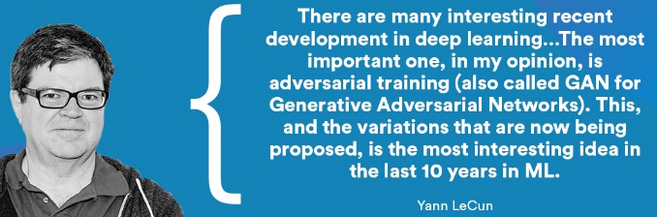
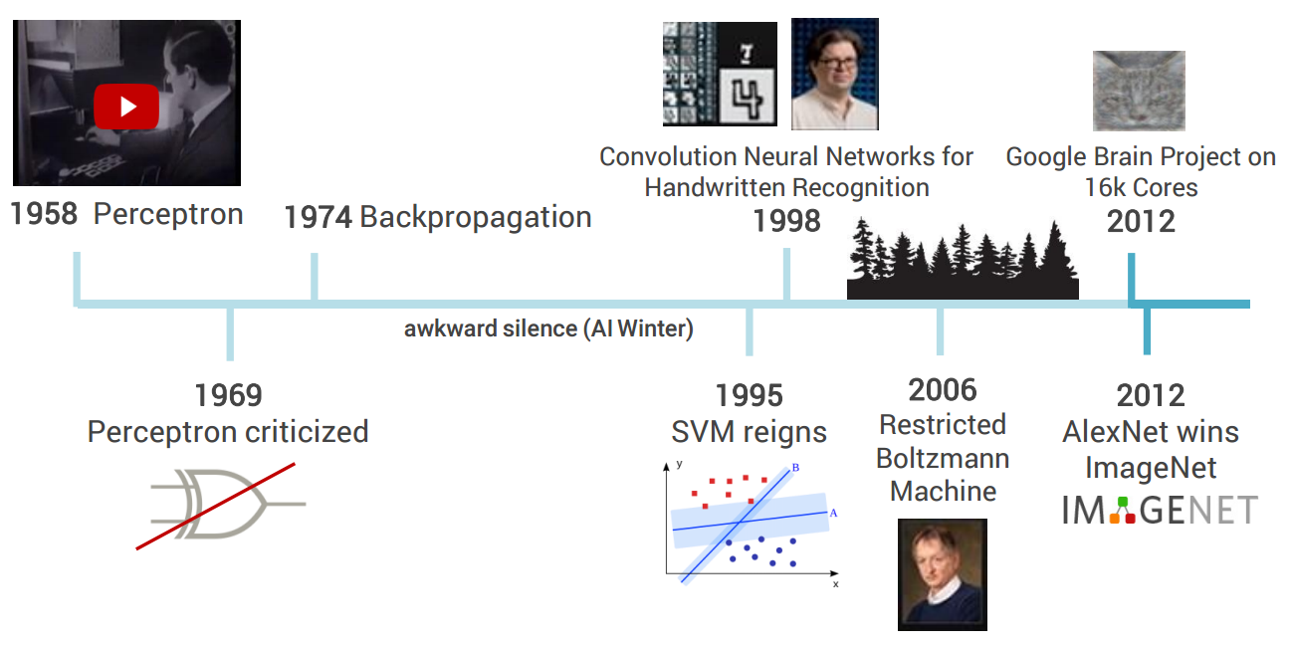
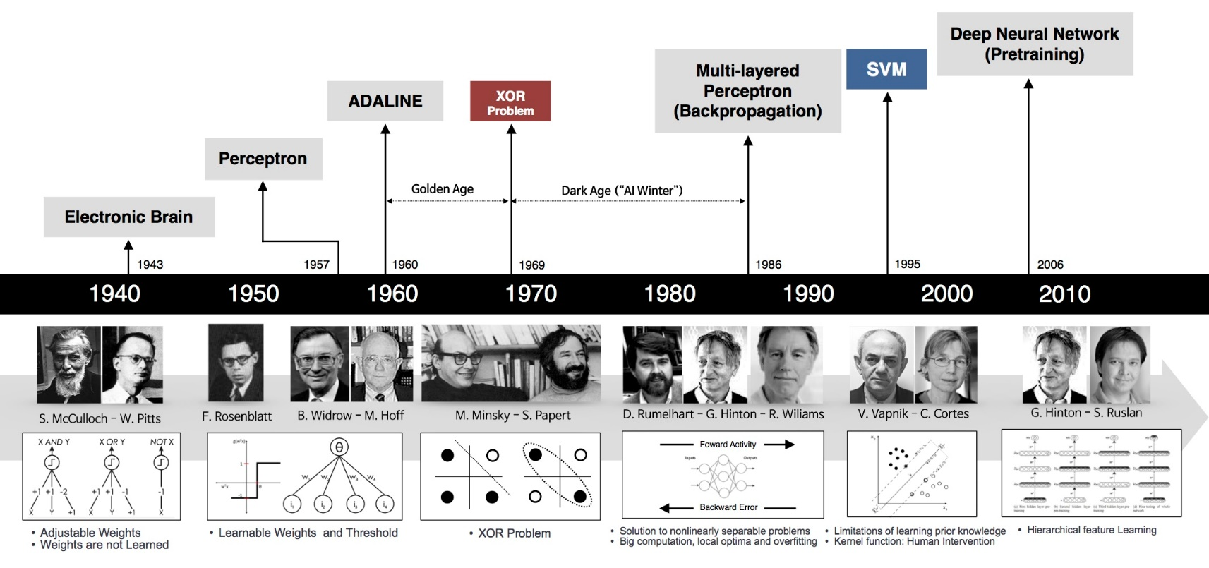
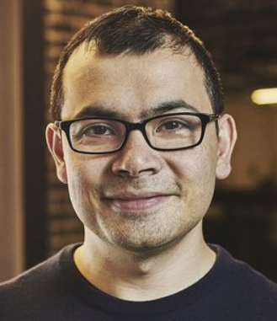
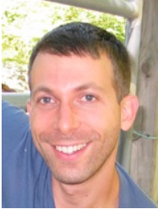

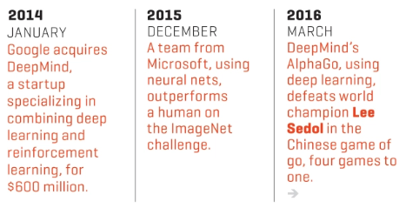
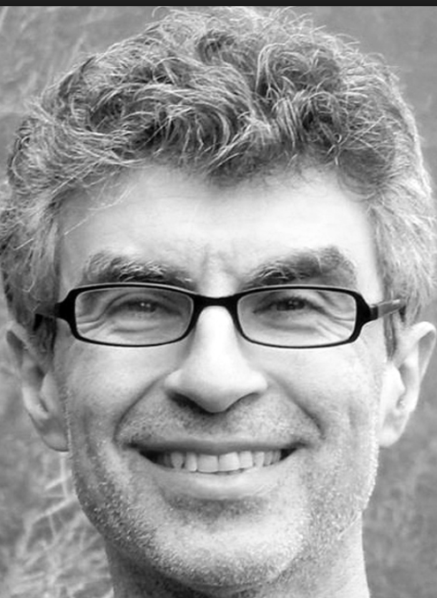
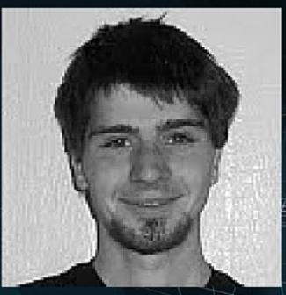
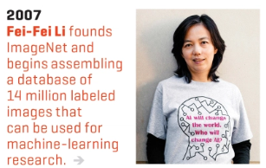
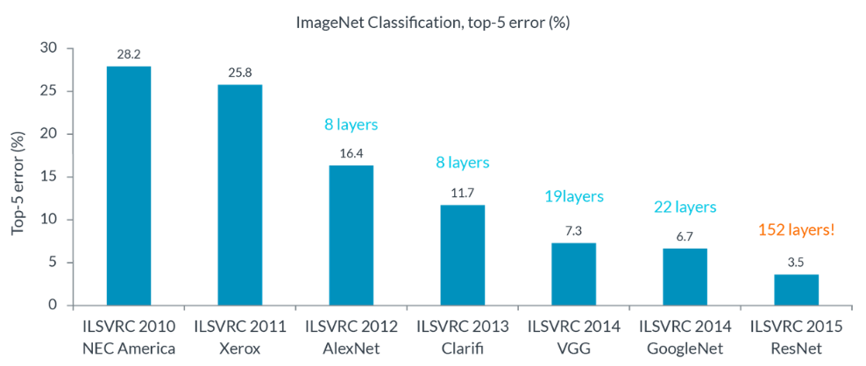
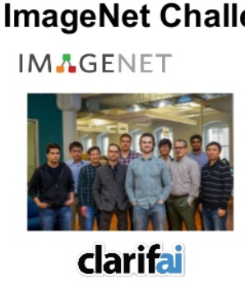
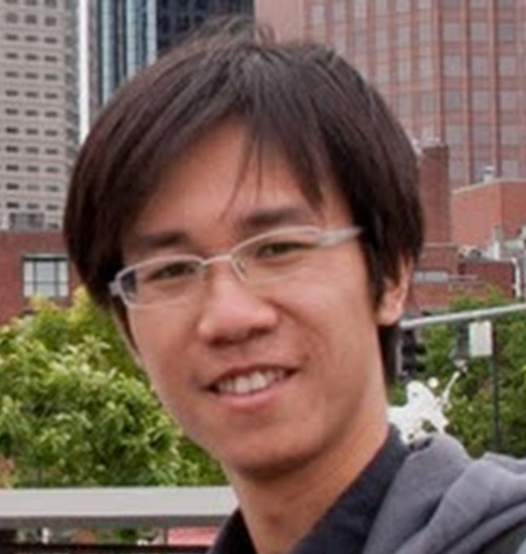
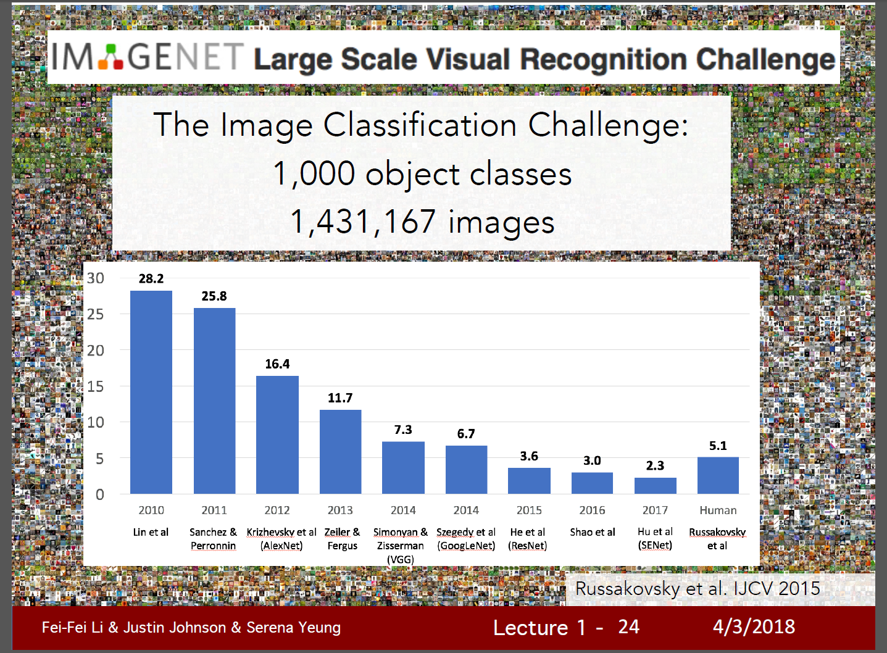
역사의 흐름 & 인물들
Y.Bengio
GAN: Ian Goodfellow
[2018 winner is ?]
http://image-net.org/challenges
2015년부터 video object detection 추가됨

Slide 3
Neural Network (NN) 의 핵심 기술들
Back propagation : 너무 기초라서 패스
CNN | Semantic seg | RNN (LSTM) | Reinforcement L.. | GAN
Batch Normalization
Dropout (DropConnection)
Data augmentation
Weight initialization
Pooling
Activation Func.
업뎃예정
* 위 항목들은 뒤 슬라이드에 모두 다룰것이다.

Slide 4
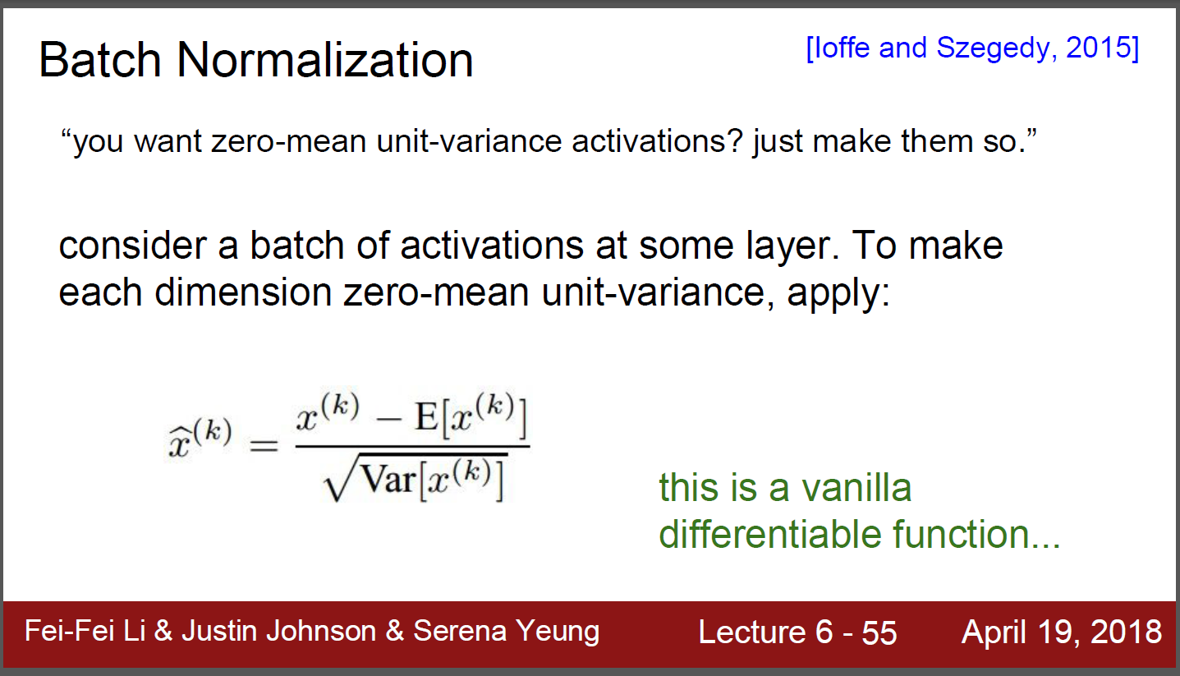
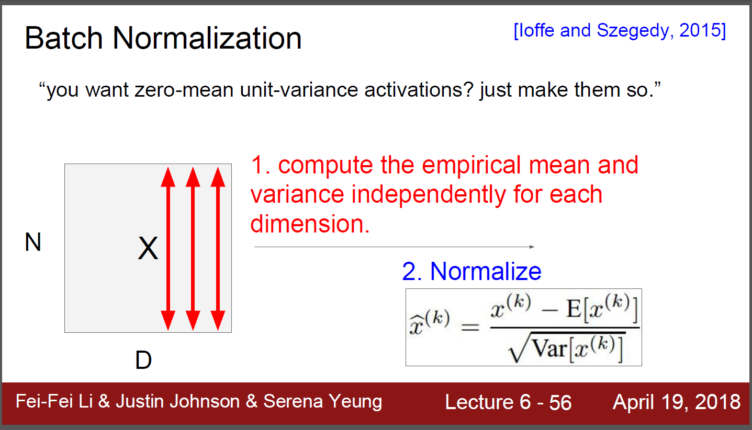
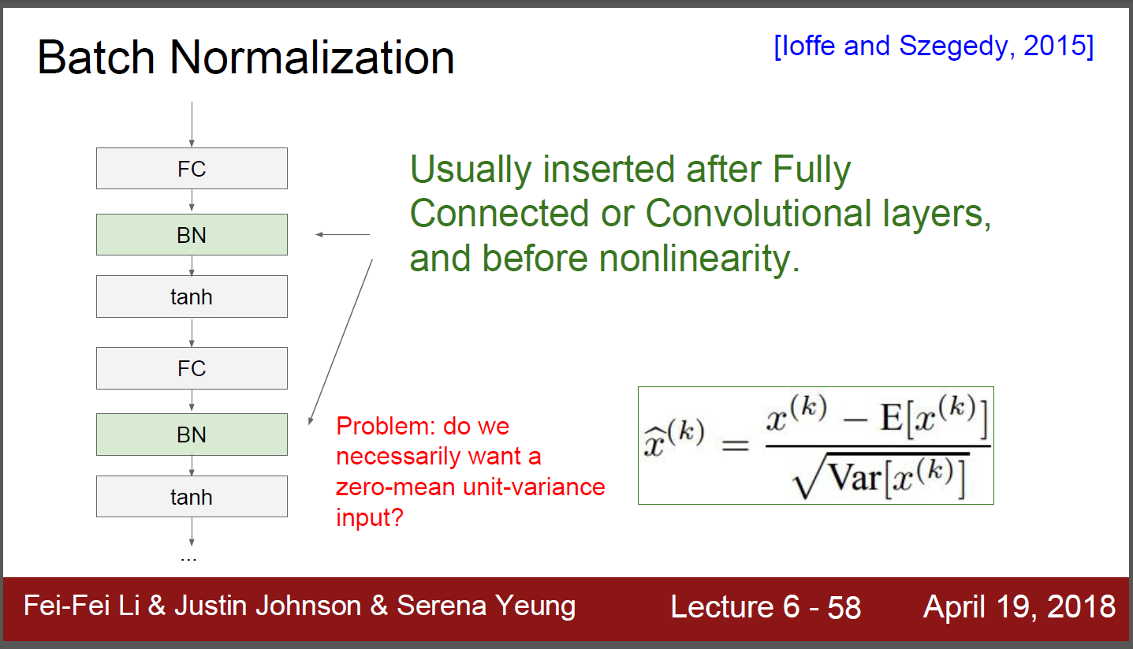
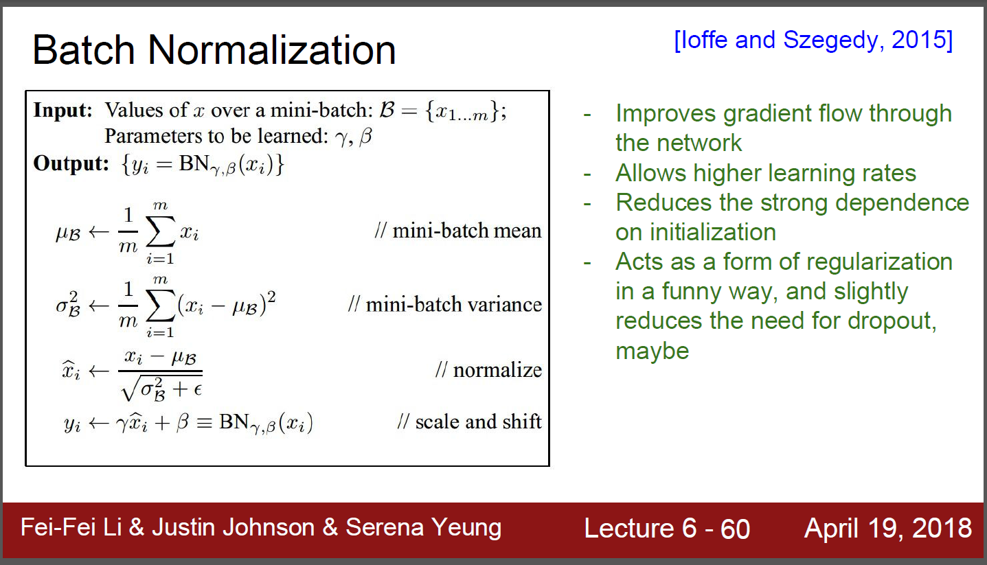
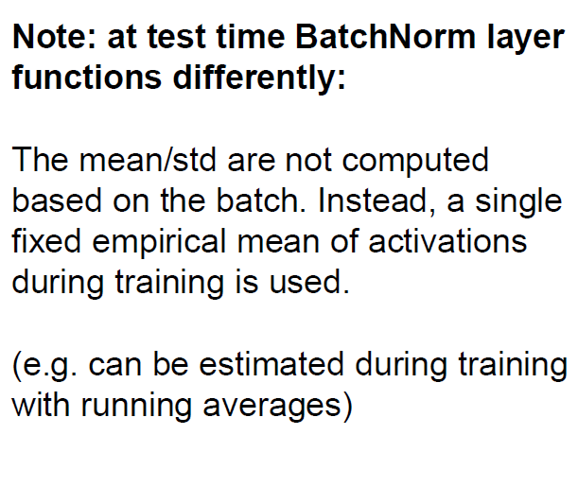
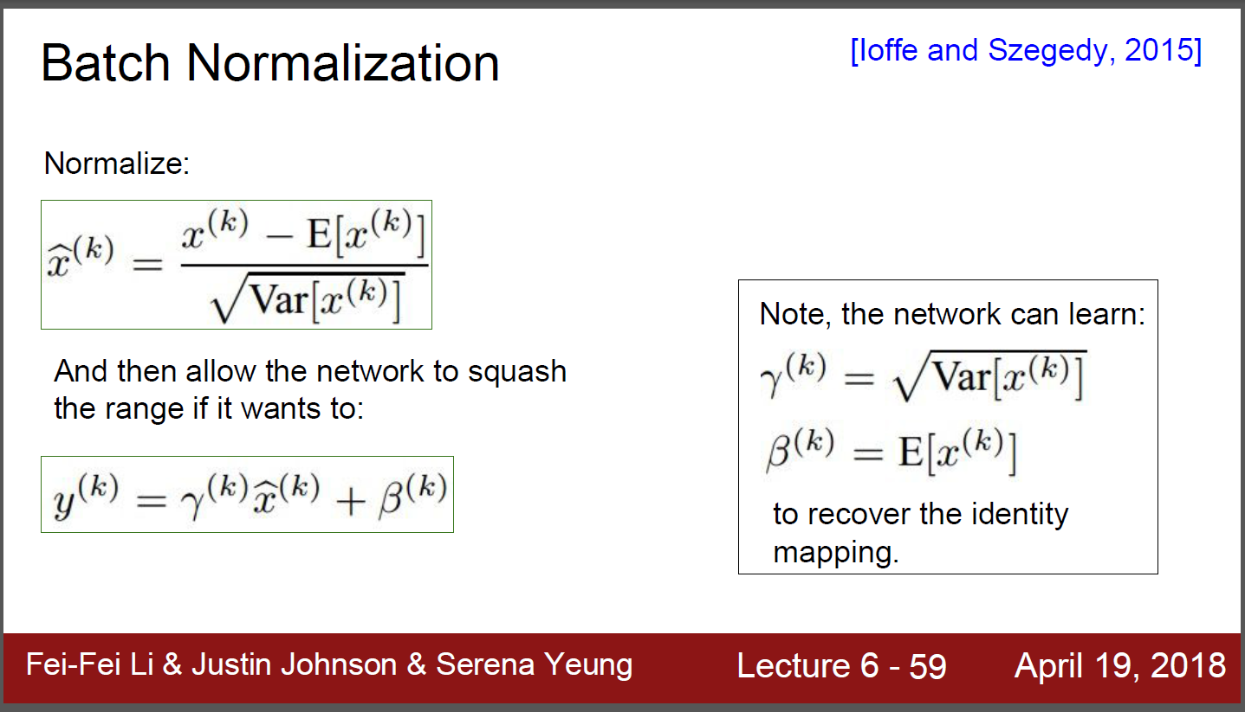
Batch normalization

Slide 5
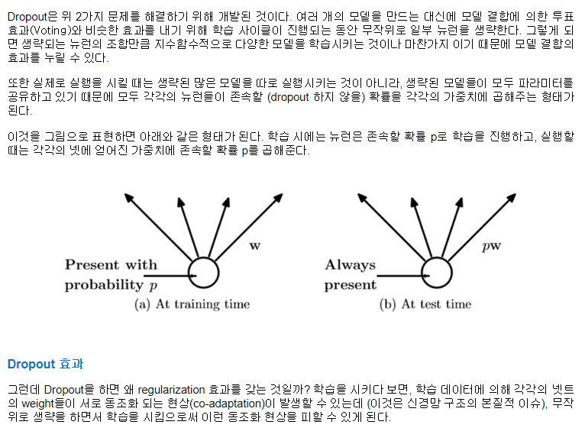
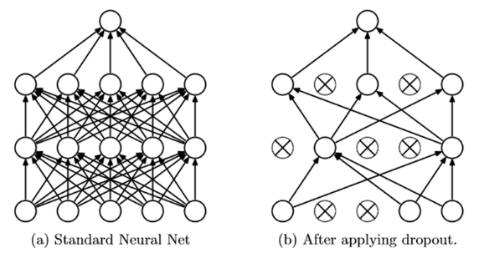
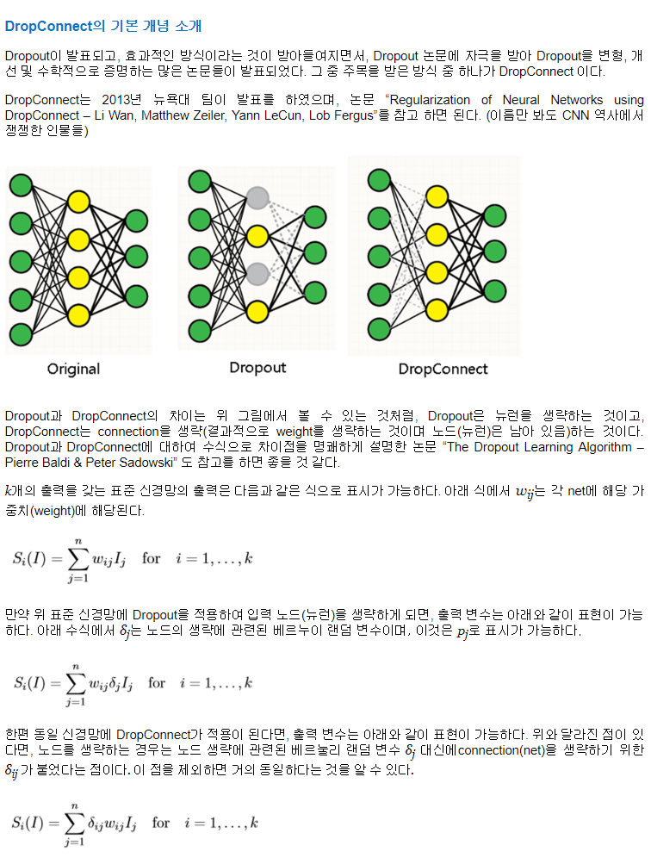
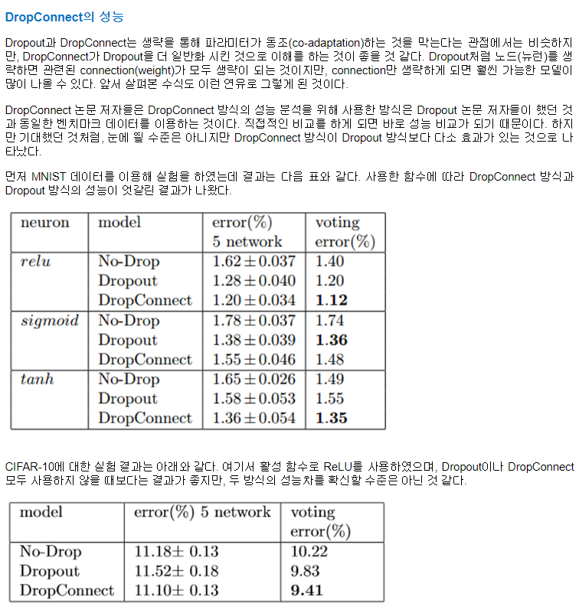
DropOut/DropConnect: for regularization
DropOut

Slide 6
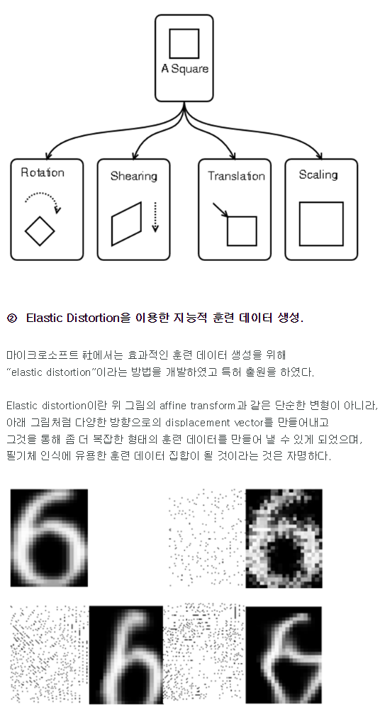
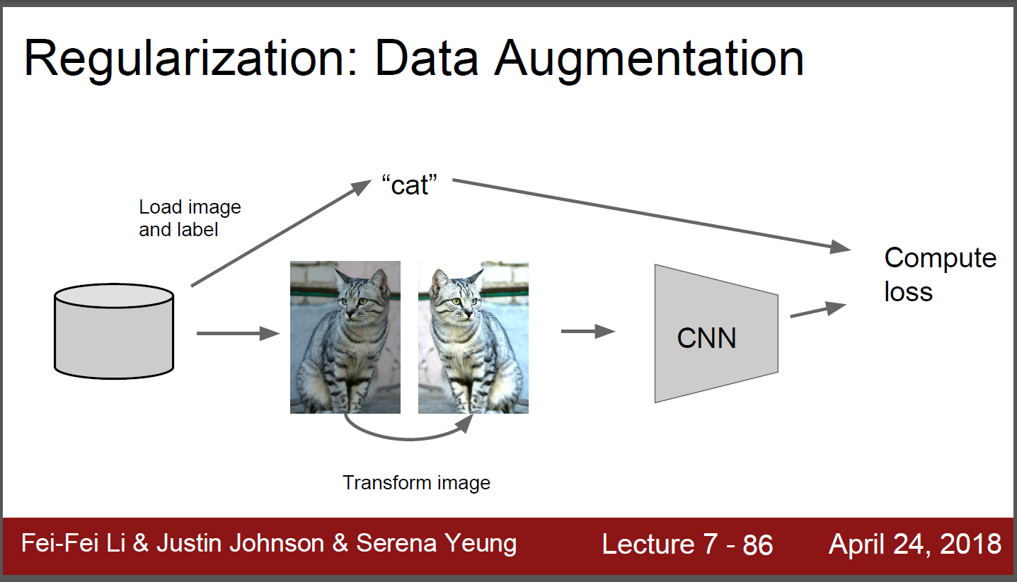
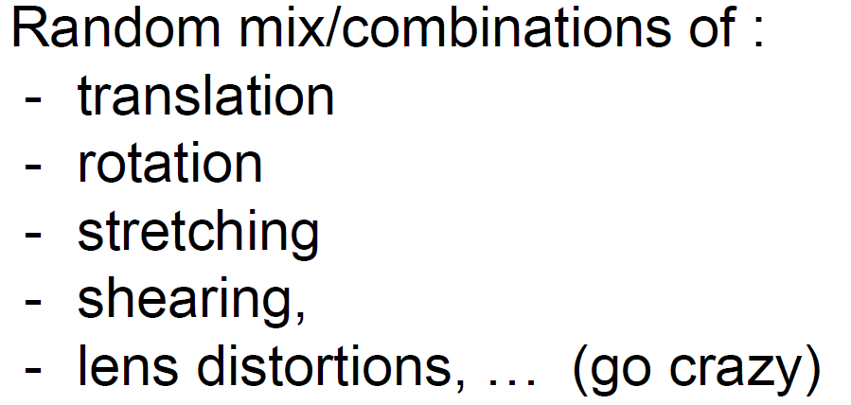
Data augmentation

Slide 7
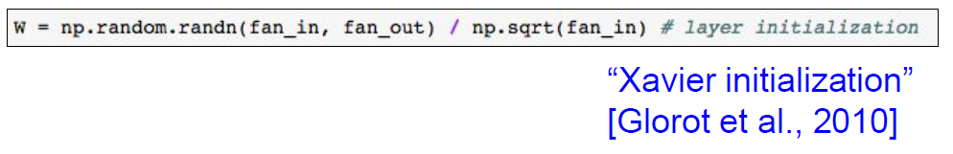
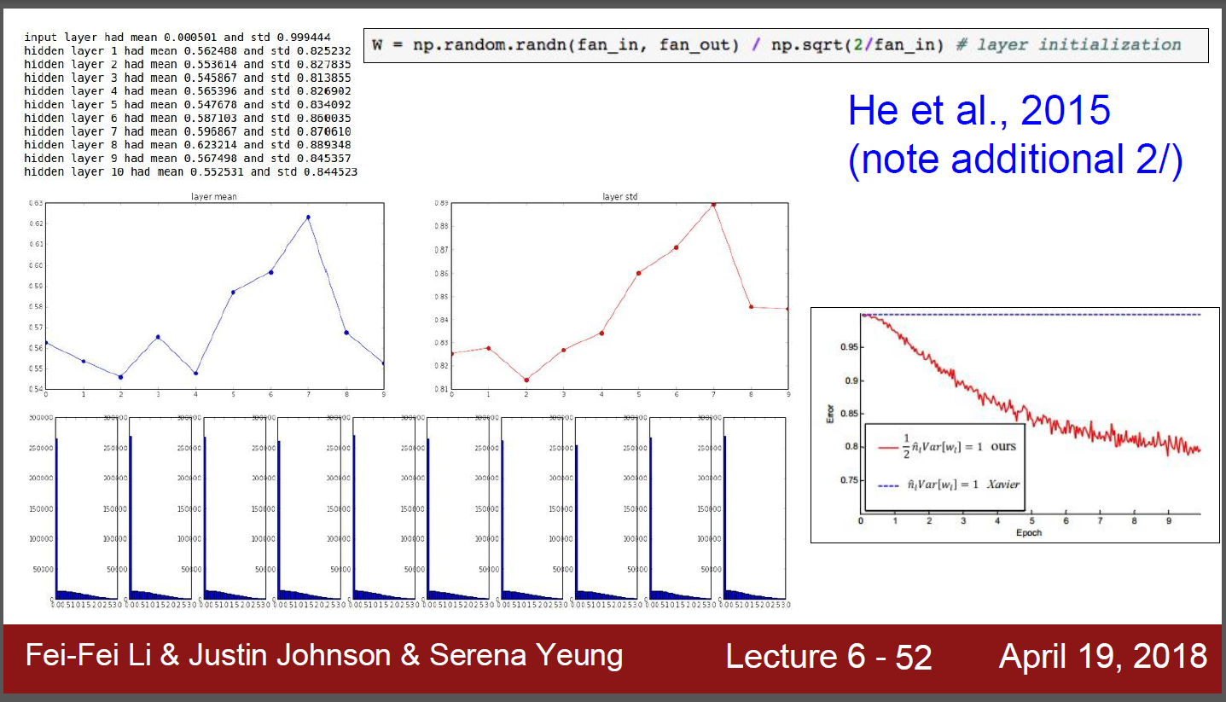
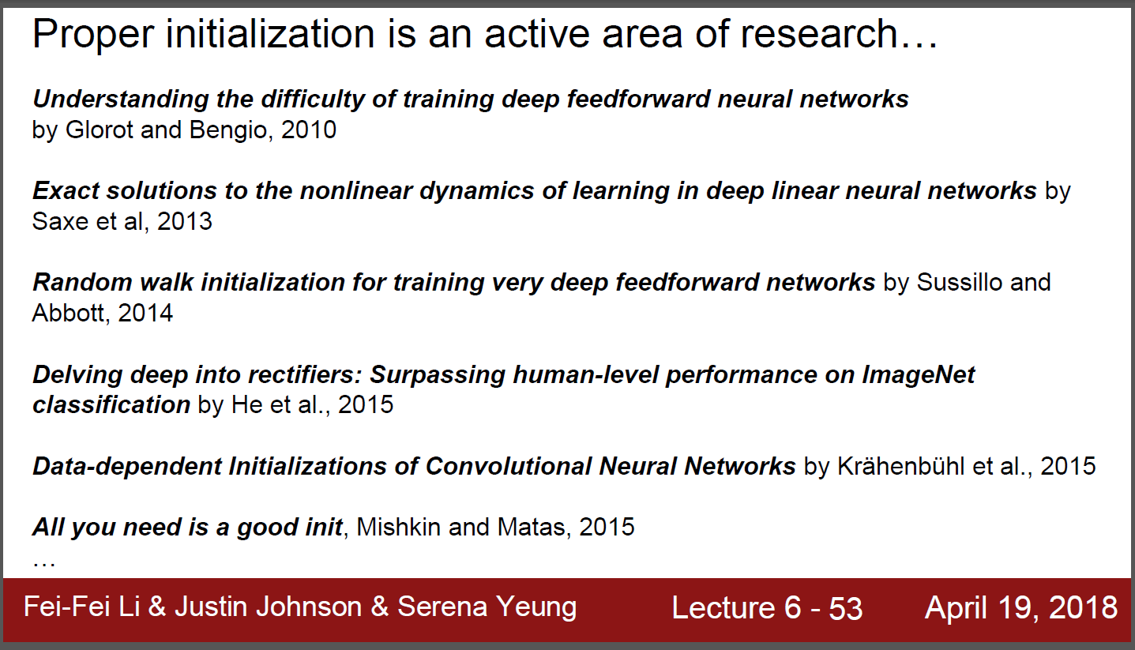
Weight initialization

Slide 8
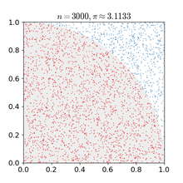
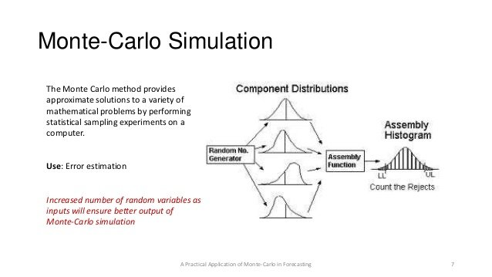
이해를 돕기 위한 기타 정보들
Monte Carlo method
1x1 convolution
Cross entropy cost function
Softmax
Bagging/adaboost
Semantic segmentation
Conditional random field (CRF)
Markov chain monte carlo (MCMC)
Convolution arithmetic (https://github.com/vdumoulin/conv_arithmetic)
Stochastic Gradient Decent (SGD), SGD + Momentum, Adam
Transfer learning with CNNs

Slide 9
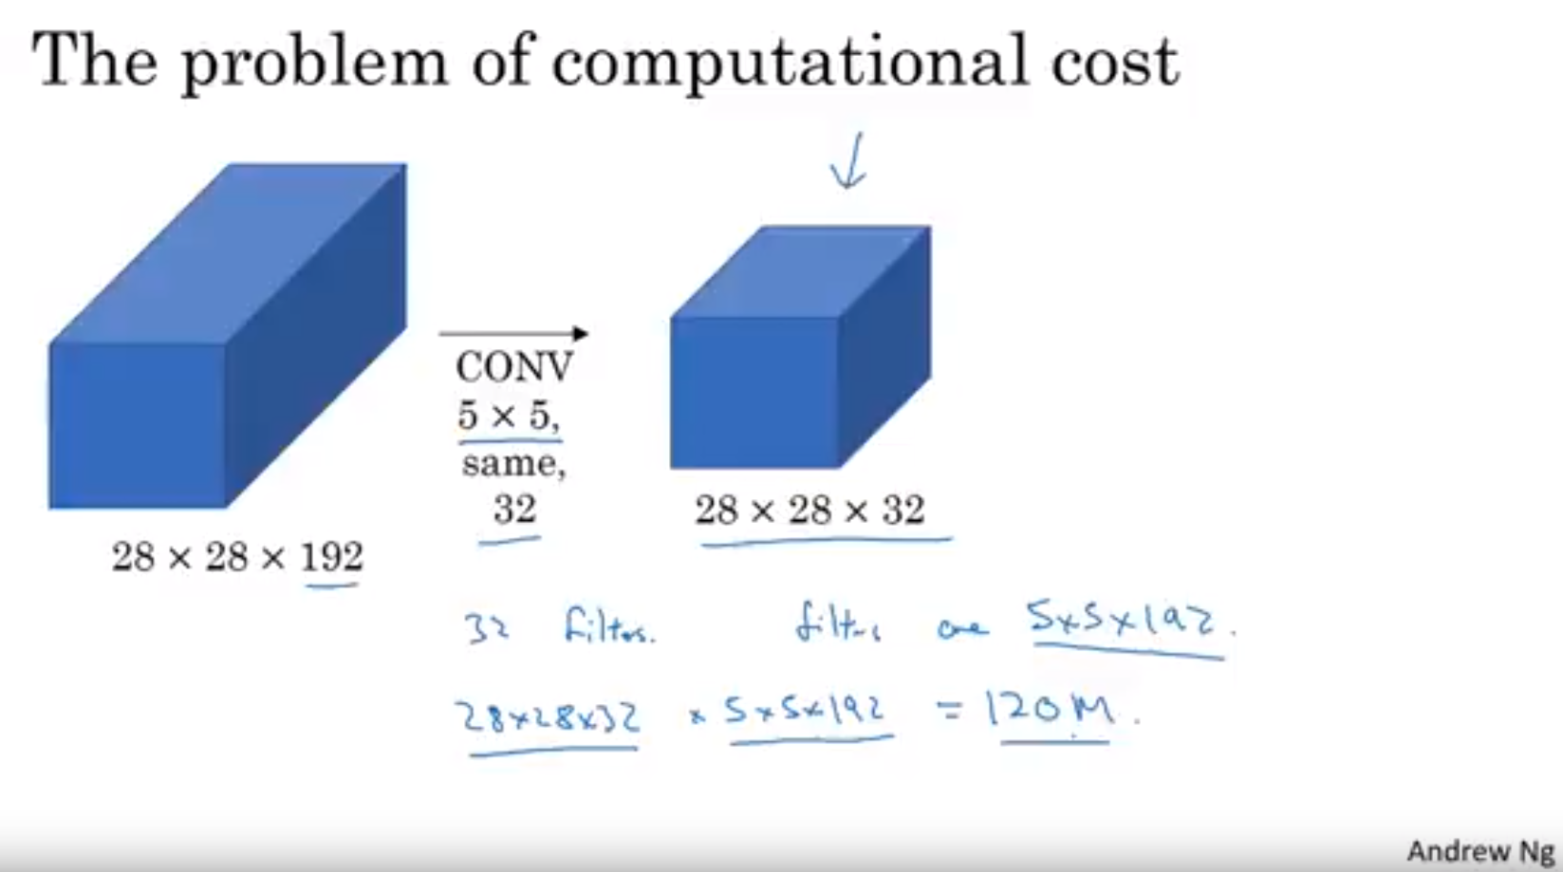
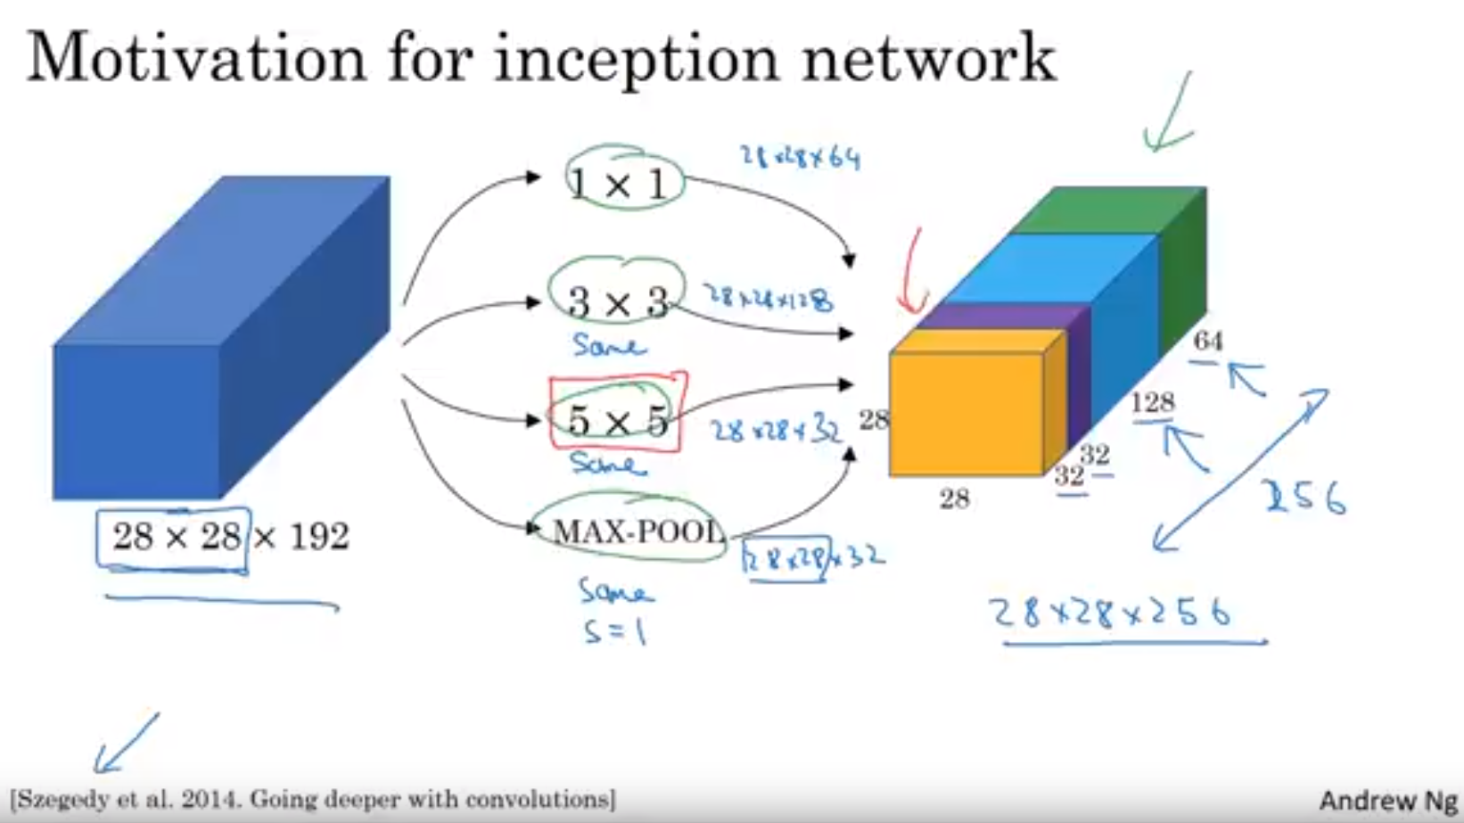
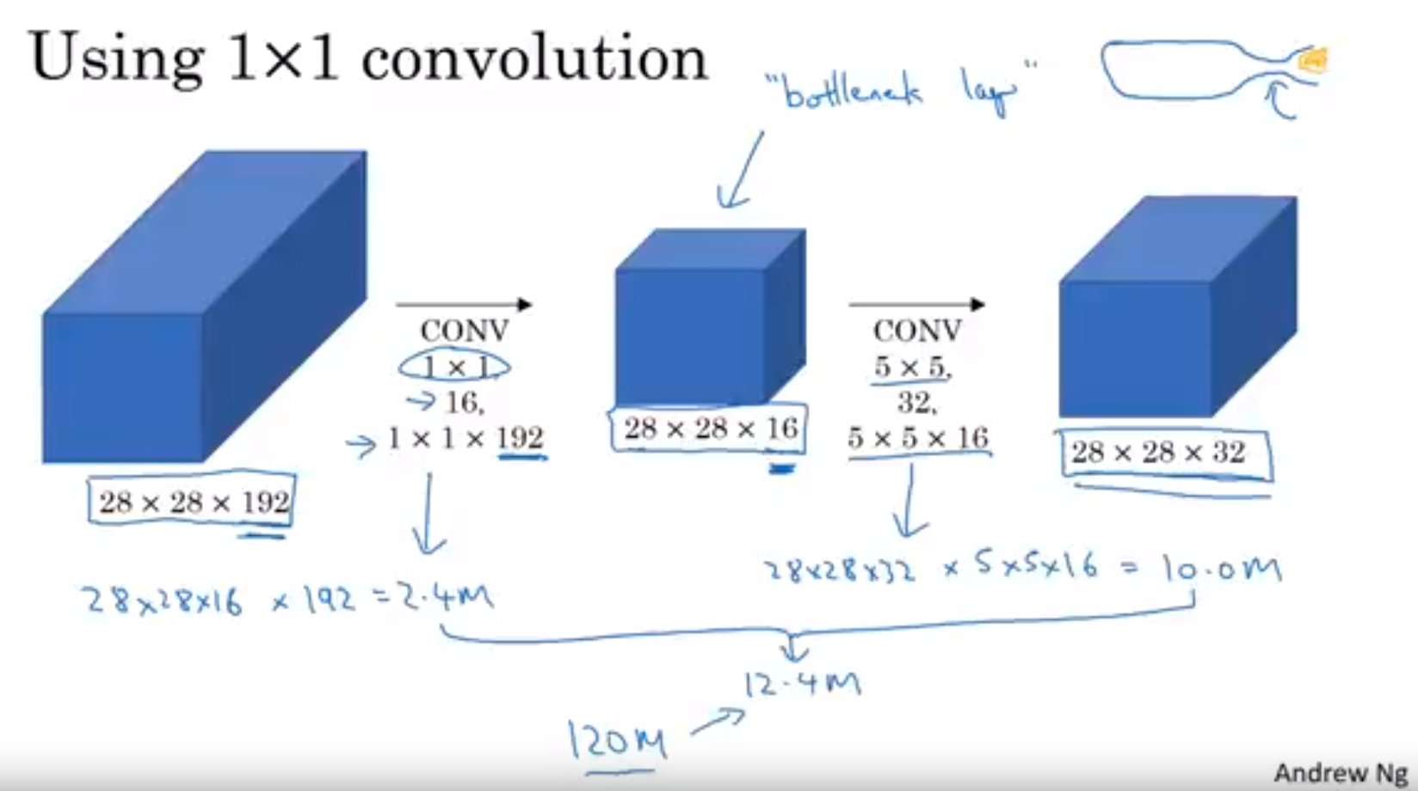
1x1 Convolution

Slide 10
Cross entropy cost function
업뎃예정

Slide 11
Softmax
업뎃예정

Slide 12
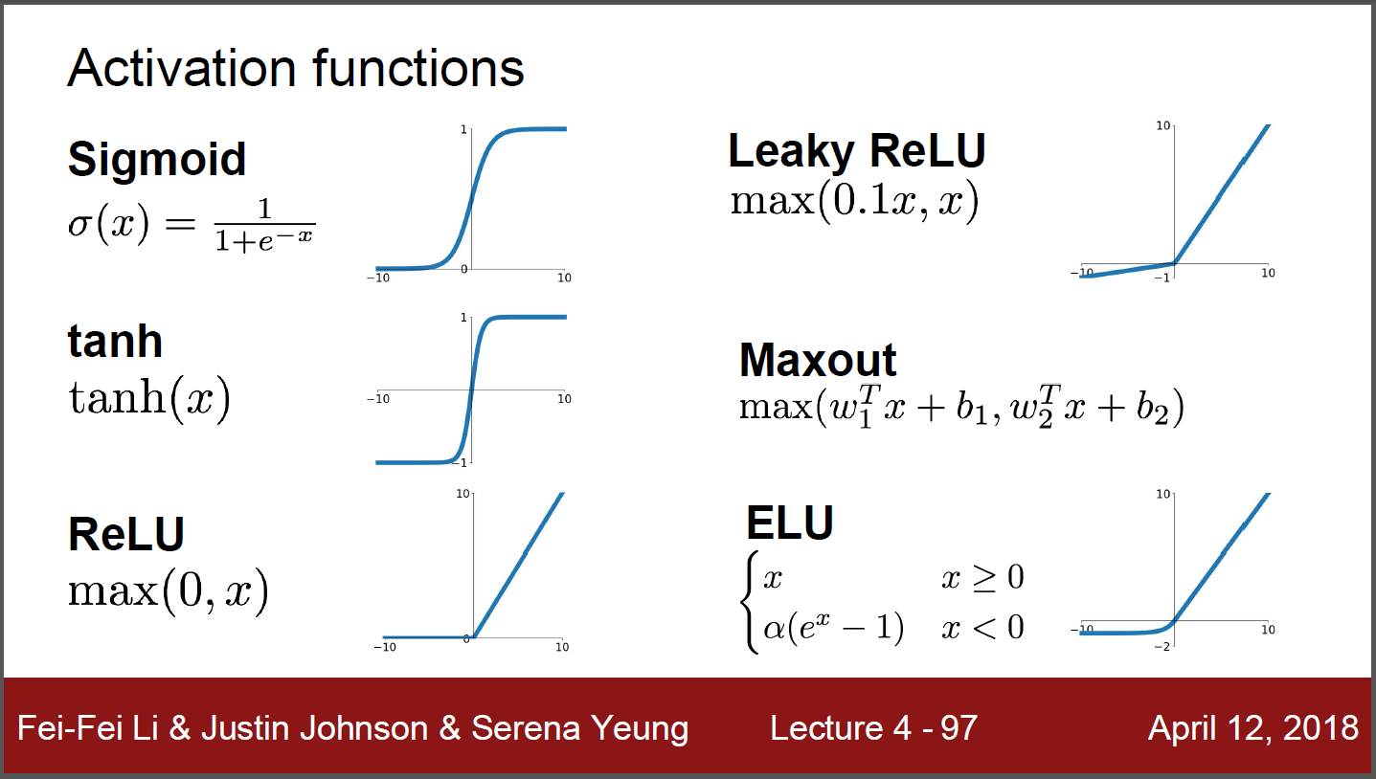
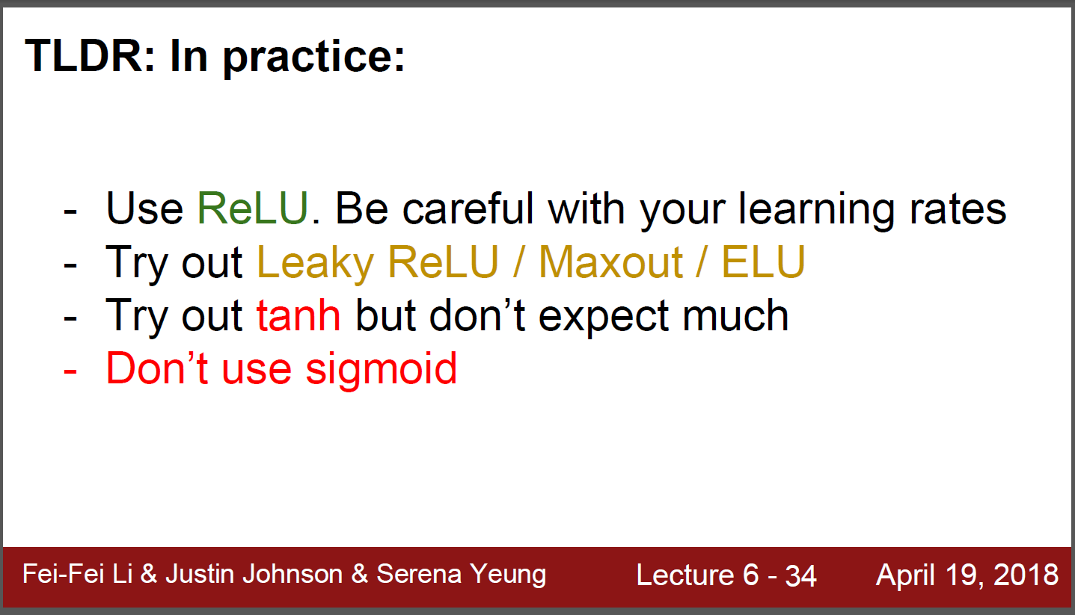
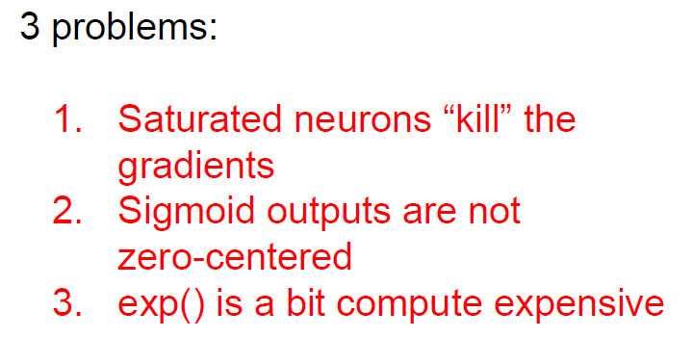
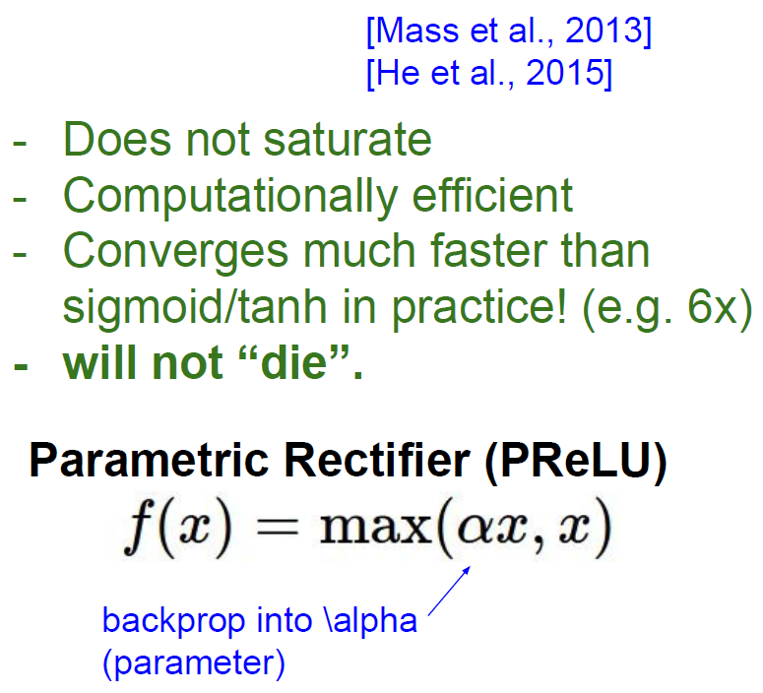
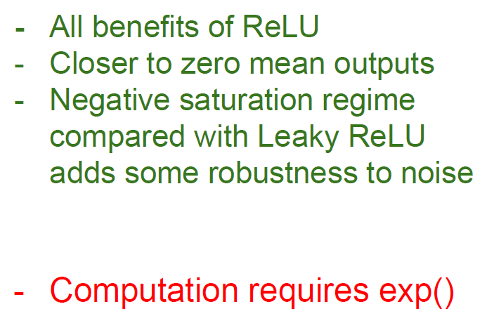
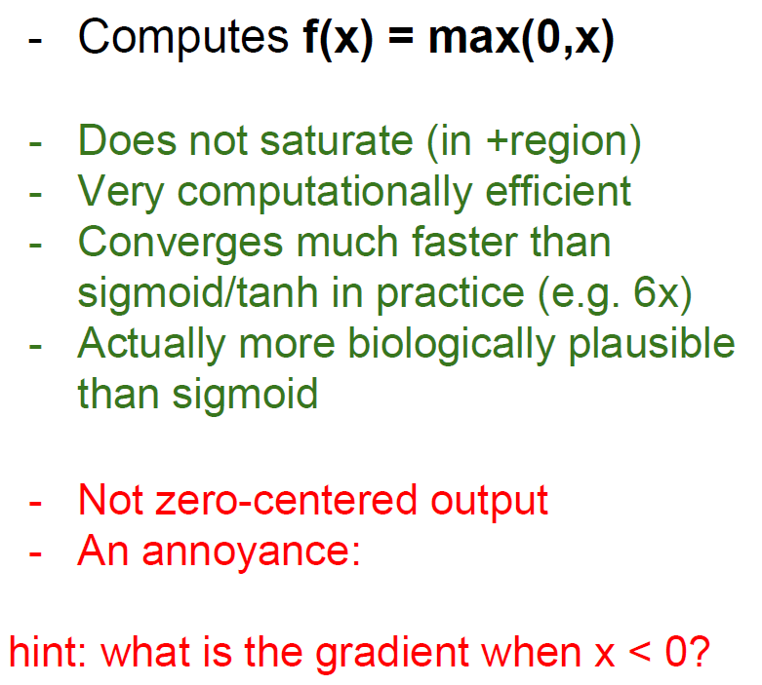
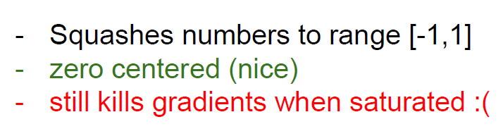
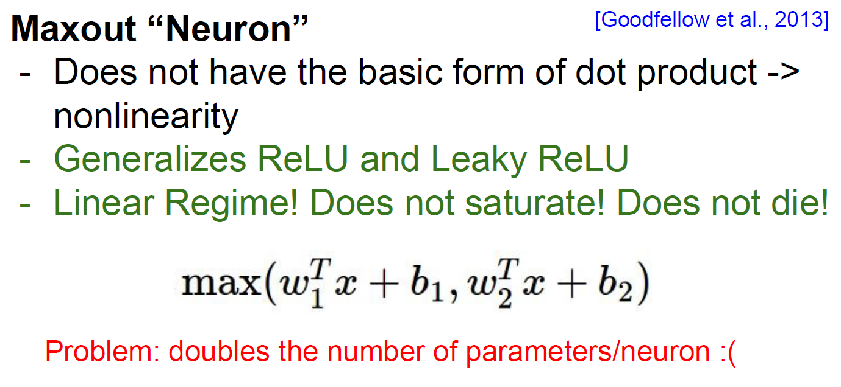
K
ReLU
Leaky ReLU
ELU
of sigmoid
Pros and cons in tanh

Slide 13
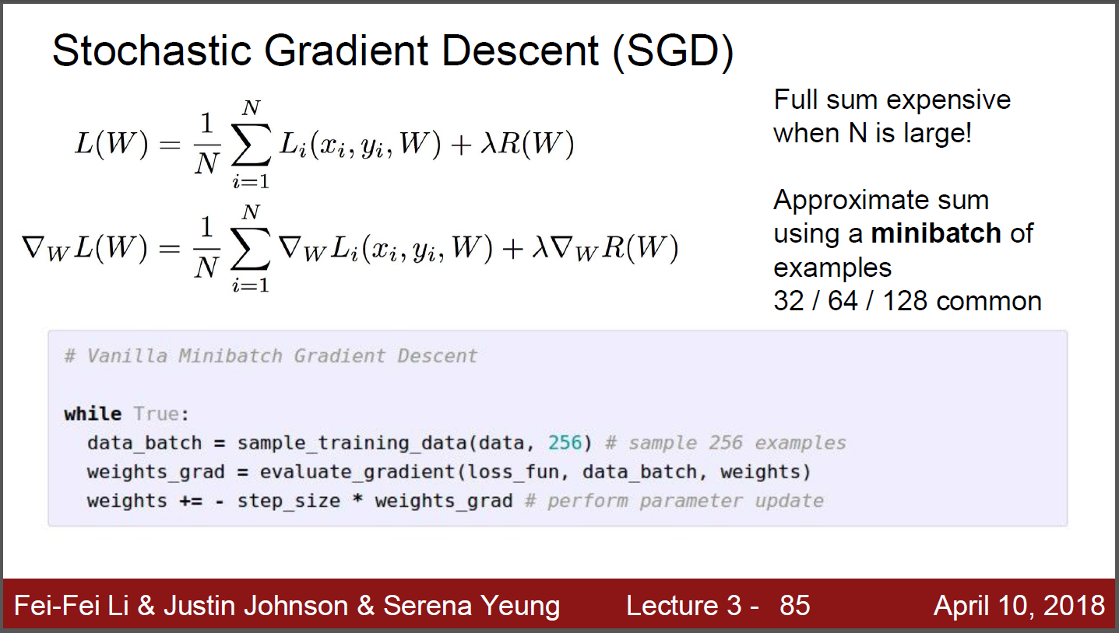
SGD

Slide 14
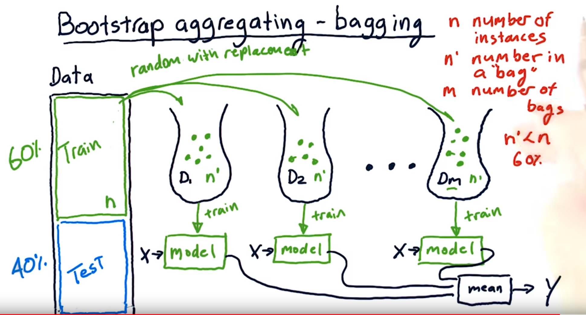
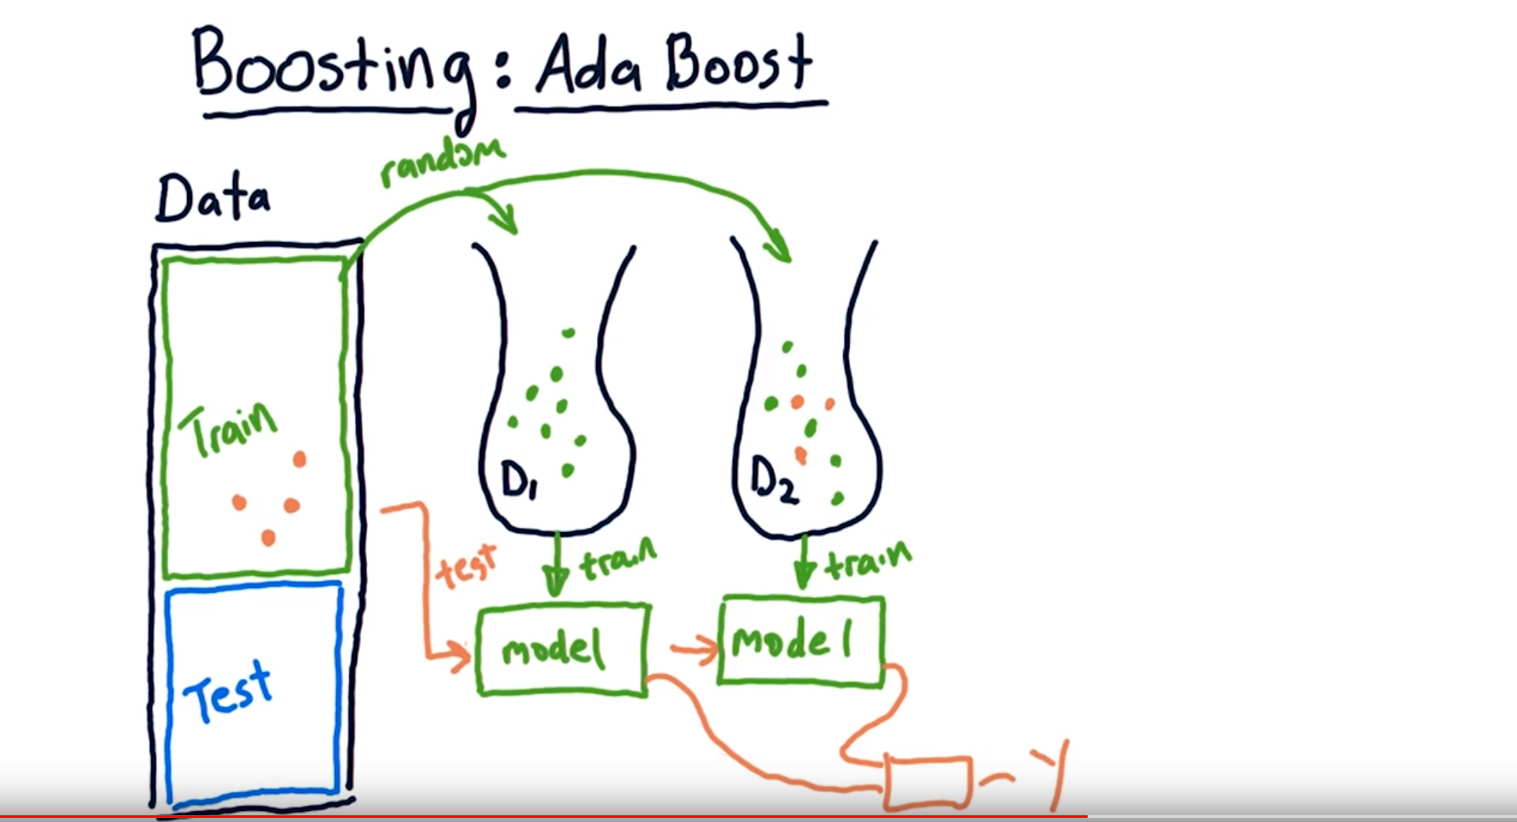
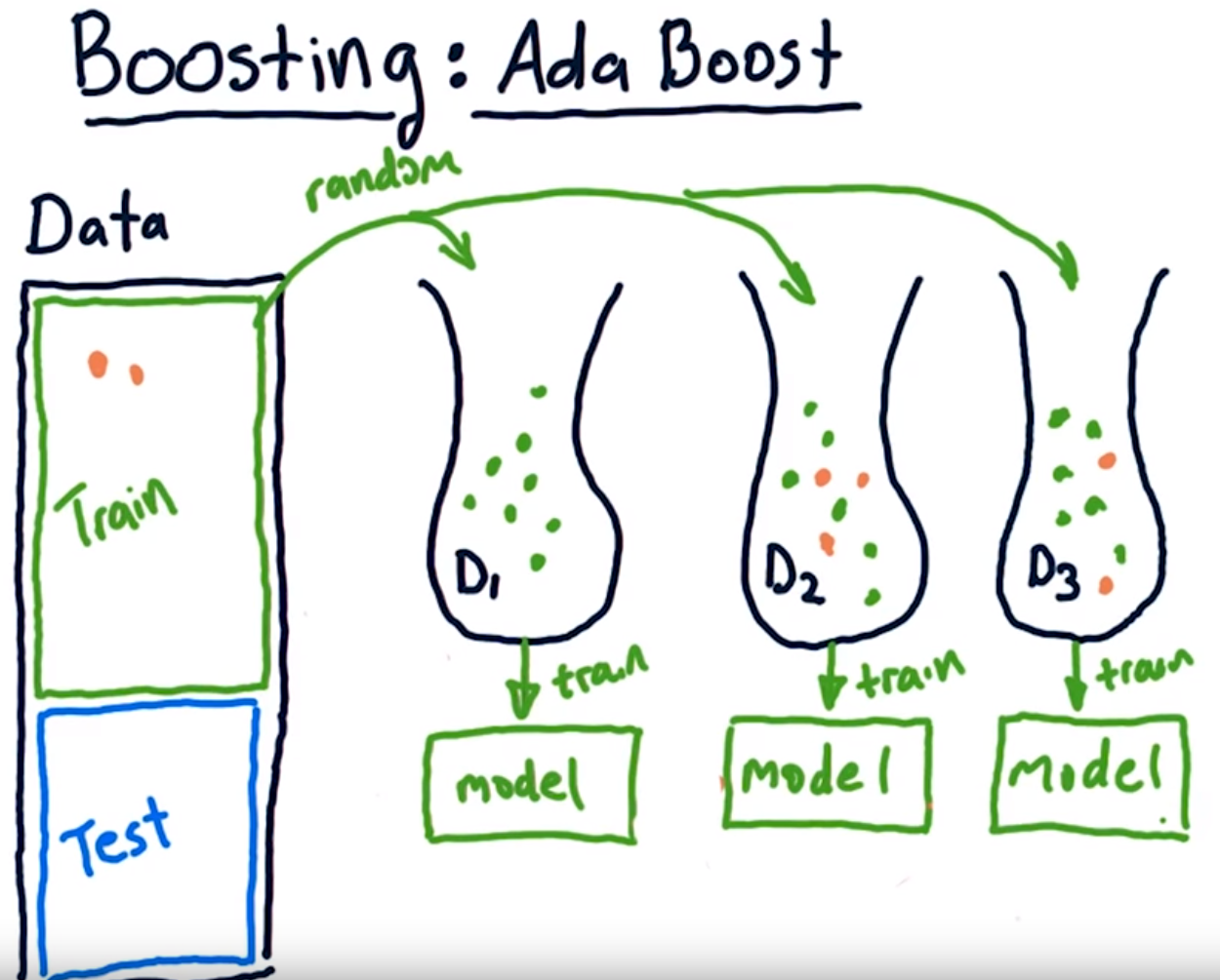
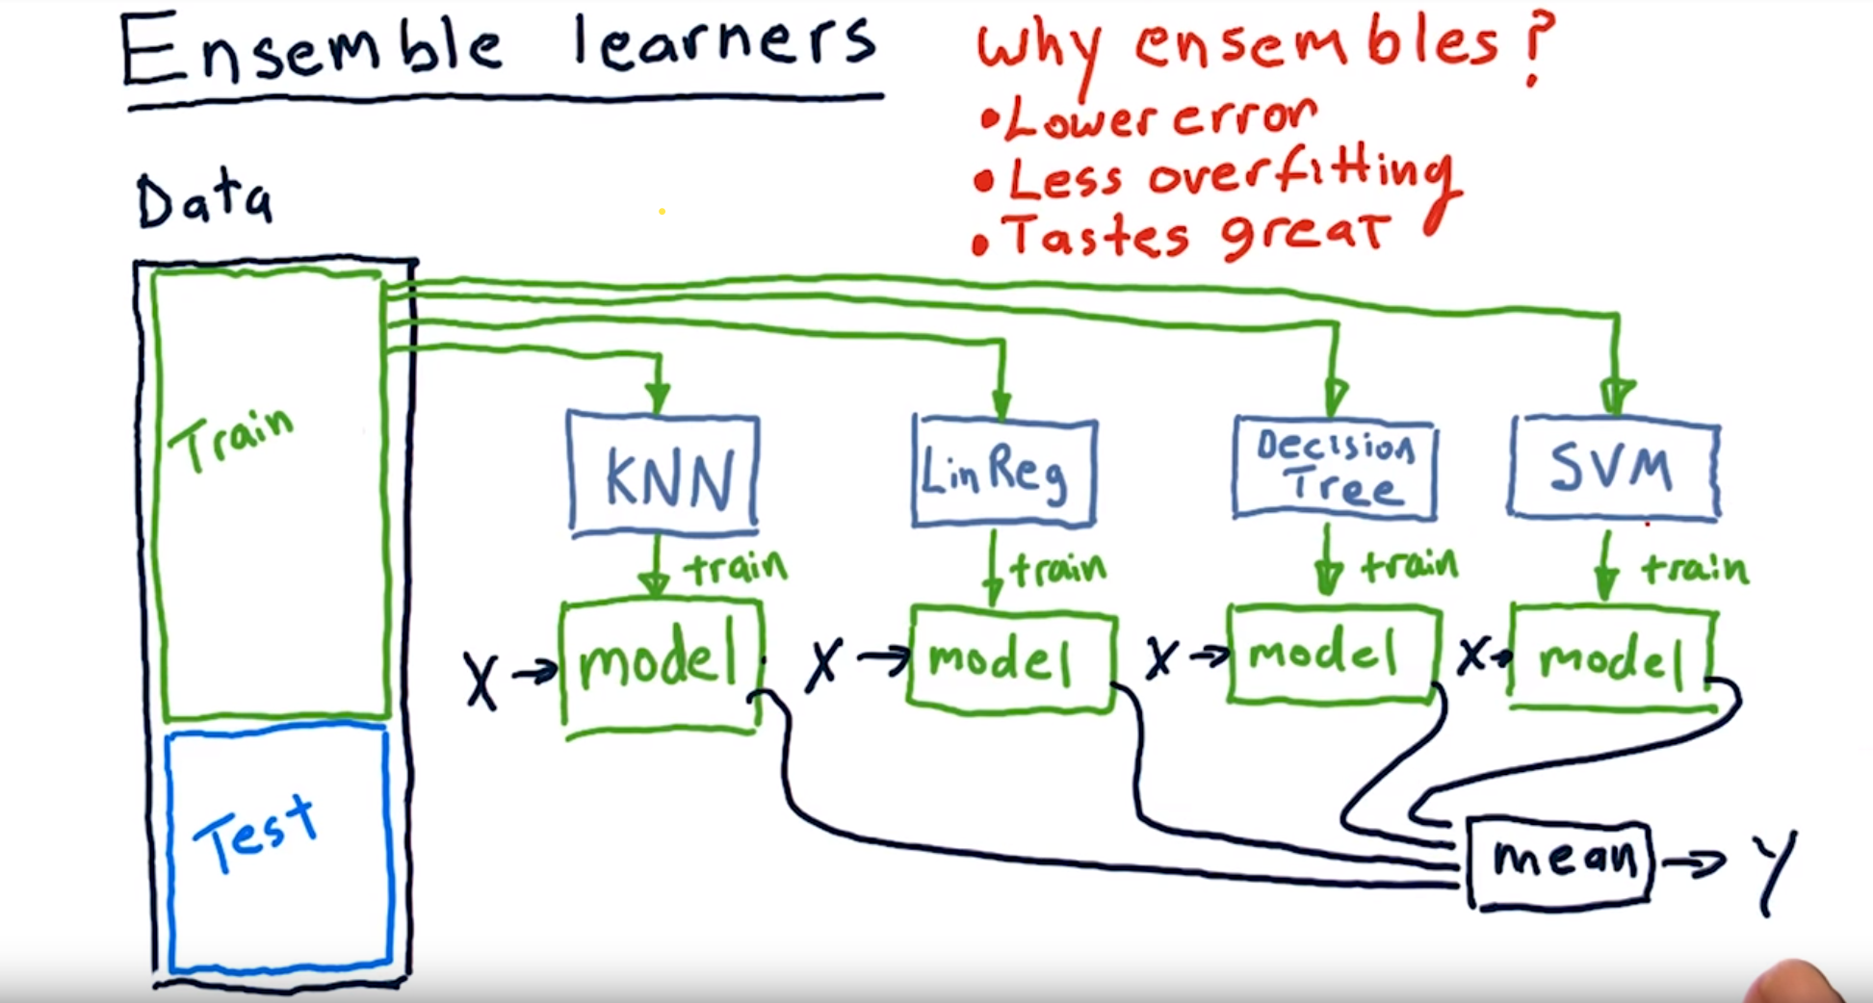
Bootstrap/Boosting

Slide 15
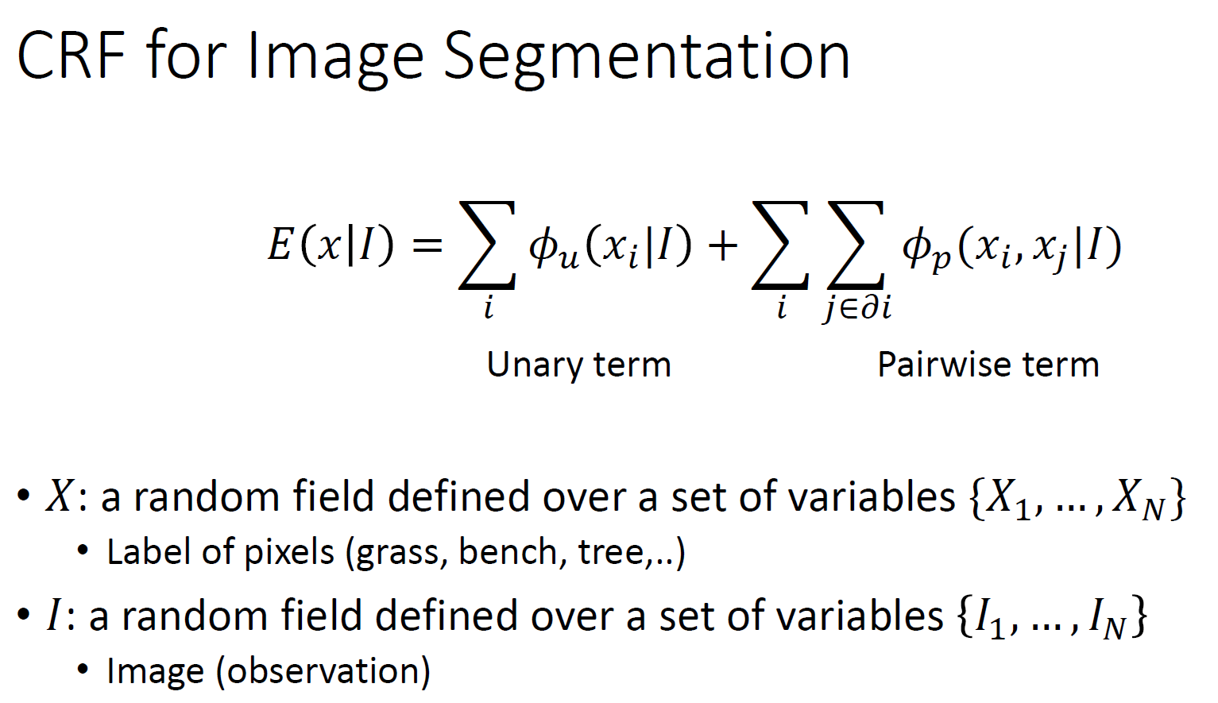
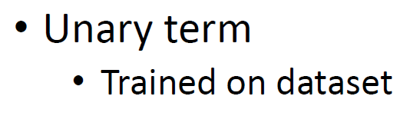
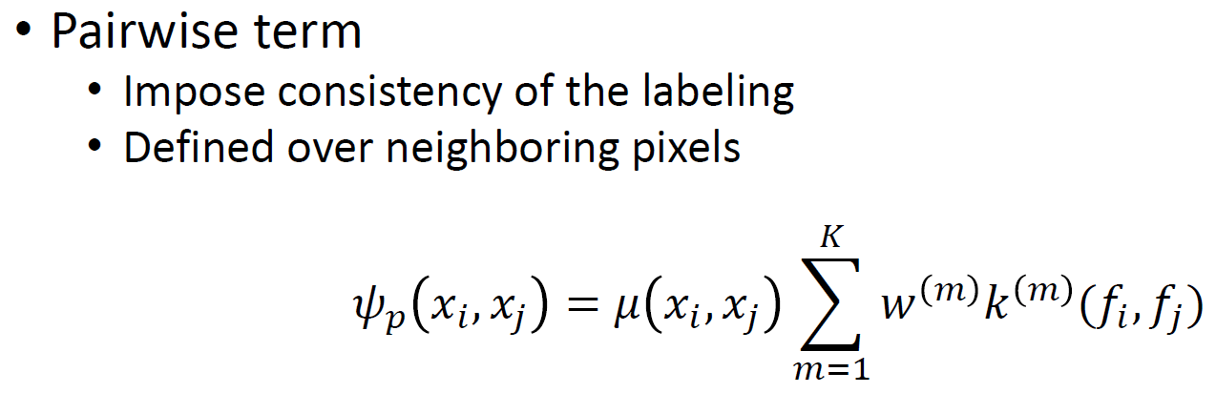






Slide 16








MCMC
http://newsight.tistory.com/102
https://youtu.be/SAknTVJ16r4
http://www.4four.us/article/2014/11/markov-chain-monte-carlo
https://ko.coursera.org/learn/probabilistic-graphical-models-2-inference/lecture/NkP41/gibbs-sampling
http://groups.csail.mit.edu/vision/sli/projects.php?name=shape_sampling

Slide 17



Convolution arithmetic
Zero padding은 왜 할까? Convolution 전/후 image의 크기를 유지하기 위함일까? Image의 경계면의 정보까지 살리기 위함이라는 것도 유념하자

Slide 18


Transfer Learning with CNN

Slide 19


Back propagation
http://home.agh.edu.pl/~vlsi/AI/backp_t_en/backprop.html

Slide 20

Linear Classifier

Slide 21


합성 신경망 Convolutional Neural Network (CNN)
Convolution layer + Pooling == creating feature maps == feature extraction?
Fully connected network == classification?

Slide 22

CNN – LeNet-5 (1998)

Slide 23




CNN – AlexNet(supervision) 2012
AlexNet significantly outperformed all the prior competitors and won the challenge by reducing the top-5 error from 26% to 15.3%.

Slide 24



CNN – ZFNet (2013)
It achieved a top-5 error rate of 14.8% which is now already half of the prior mentioned non-neural error rate. It was mostly an achievement by tweaking the hyper-parameters of AlexNet while maintaining the same structure with additional Deep Learning elements as discussed earlier in this essay.

Slide 25



GoogLeNet (2014)
The winner of the ILSVRC 2014 competition was GoogleNet(a.k.a. Inception V1) from Google. It achieved a top-5 error rate of 6.67%! This was very close to human level performance which the organisers of the challenge were now forced to evaluate.
The network used a CNN inspired by LeNet but implemented a novel element which is dubbed an inception module.
It used batch normalization, image distortions and RMSprop. This module is based on several very small convolutions in order to drastically reduce the number of parameters.
Their architecture consisted of a 22 layer deep CNN but reduced the number of parameters from 60 million (AlexNet) to 4 million.

Slide 26


VGGNet (2014)
VGGNet consists of 16 convolutional layers and is very appealing because of its very uniform architecture. Similar to AlexNet, only 3x3 convolutions, but lots of filters.
The weight configuration of the VGGNet is publicly available and has been used in many other applications and challenges as a baseline feature extractor. However, VGGNet consists of 138 million parameters, which can be a bit challenging to handle.

Slide 27

ResNet (2015)
at the ILSVRC 2015, the so-called Residual Neural Network (ResNet) by Kaiming He et al introduced a novel architecture with “skip connections” and features heavy batch normalization.
Such skip connections are also known as gated units or gated recurrent units and have a strong similarity to recent successful elements applied in RNNs.
Thanks to this technique they were able to train a NN with 152 layers while still having lower complexity than VGGNet. It achieves a top-5 error rate of 3.57% which beats human-level performance on this dataset.

Slide 28
참고문헌
http://cs231n.stanford.edu/
http://emergent-enterprise.com/2016/10/why-deep-learning-is-suddenly-changing-your-life-part-ii/
https://beamandrew.github.io/deeplearning/2017/02/23/deep_learning_101_part1.html
https://www.slideshare.net/xavigiro/deep-learning-for-computer-vision-14-image-analytics-lasalle-2016
Andrew Ng, Coursera
https://medium.com/@siddharthdas_32104/cnns-architectures-lenet-alexnet-vgg-googlenet-resnet-and-more-666091488df5
https://laonple.blog.me

Slide 29


ImageNet 이란?

